Slide 2
Central Intervention Team Members:
Erin Davis, LISW-S - Central Intervention Team Lead edavis3@amerihealthcaritasoh.com
Darin Hurst, MHA, LSW, LPN – Central Team Provider Engagement Lead darin.hurst@caresource.com
Nora Trimboli – Central Team Quality Intervention Lead Nora.Trimboli@anthem.com
Northwest Intervention Team Members:
Pam Sanborn, LISW-S – Northwest Intervention Team Lead pam.sanborn@caresource.com
Mary Anne Mayle – Northwest Team Provider Engagement Lead mmayle@amerihealthcaritasoh.com
Erin Tilbert, M.Ed, LPCC-S – Northwest Team Quality Intervention Lead erin_tilbert@uhc.com
Collaborative Core Leads:
Shelly Milvet, DNP, MHA, RN – Core MCO Lead shelly.milvet@uhc.com
Misty Nahay – Core QI Lead – mnahay@humana.com
Mary Kickel – Project Manager mkickel@humana.com

Slide 3
All MCO Quality Improvement Collaborative
The All MCO Quality Improvement Collaborative represents a dynamic partnership between the Ohio Department of Medicaid (ODM) and the state’s Medicaid Managed Care Organizations (MCOs). The goal of the collaborative is to address statewide health priorities and disparities. By leveraging collective experiences and using proven quality improvement science methodologies, the collaborative aims to achieve measurable and sustainable improvements in Medicaid health outcomes.
Adult Focused Project: 7-Day Follow-Up after ED Visit for Substance Use Disorder & 7-Day Follow-Up after ED Visit for Mental Health
The adult focused projects focus of providing Medicaid members with timely and coordinated care after emergency room visits for substance use and mental health diagnosis, connecting them to the right treatment and resources to improve health outcomes and promote effective engagement with the systems of care.

Slide 4
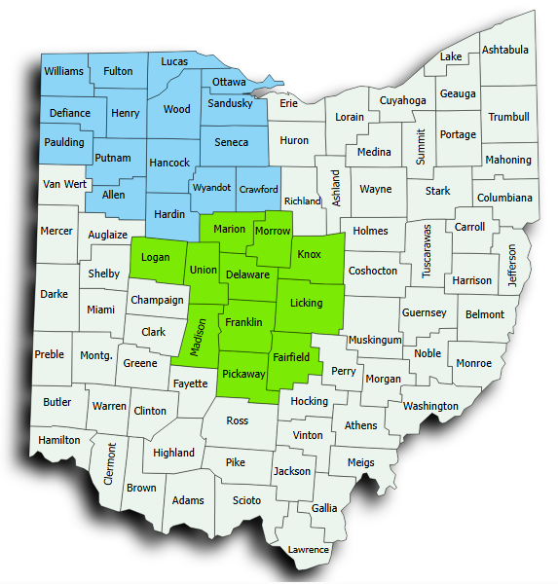
SMART AIMs*
Intervention/testing efforts are focused in the Central & Northwest Region​s:
FUA Overall Smart Aim:​
Increase the rate of follow-Up visits within 7 days of an ED visit for substance use for all adults on Medicaid aged 18 and older up to 39.04% by December 31, 2025. ​
  Black Adults
  Non-Black Adults
EDM-A Overall Smart AIM: ​
Increase the rate of follow-up visits within 7 days of an ED visit for mental health for all adults on Medicaid aged 18 and older to 39.01% by December 31, 2025. ​
  Black Adults
  Non-Black Adults
*Note: SMART Aims may be adjusted through the project lifecycle based on new information.

Slide 5
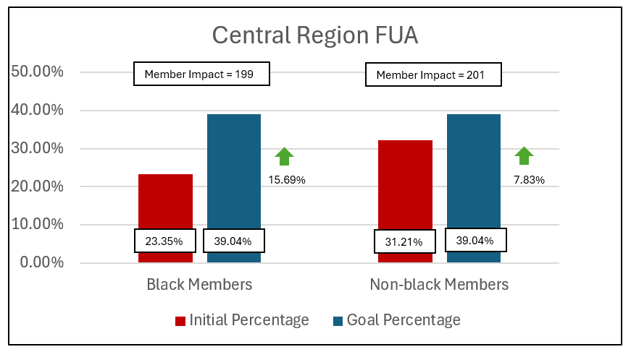
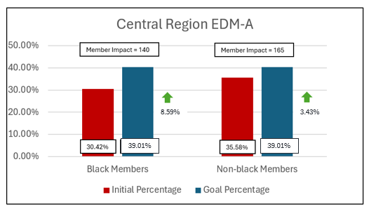
Project Populations – Central Region
Measure | Population | Total Population Count | Initial Percentage | Goal Percentage | Initial Denominator | Goal Denominator | Member Impact*
FUA | Black Members | 1270 | 23.35% | 39.04% | 297 | 496 | 199 Members
FUA | Non-black Members | 2937 | 32.21% | 39.04% | 946 | 1147 | 201 Members
EDM-A | Black Members | 1412 | 30.42% | 39.01% | 430 | 570 | 140 Members
EDM-A | Non-black Members | 3454 | 35.58% | 39.01% | 1229 | 1394 | 165 Members
*Member Impact = # of members needed to improve to the defined goal

Slide 6
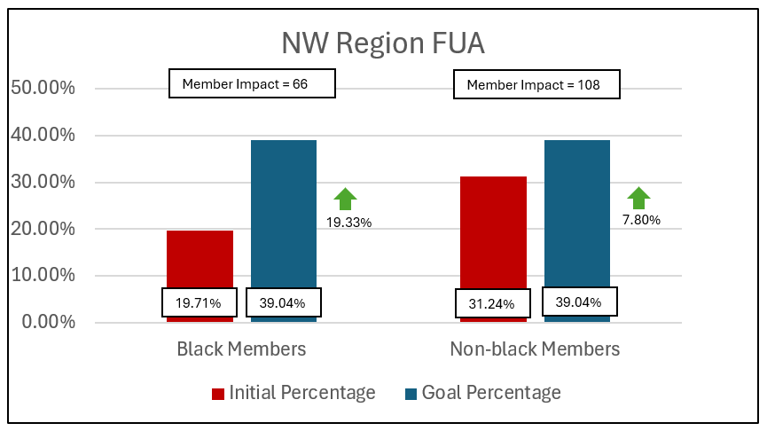
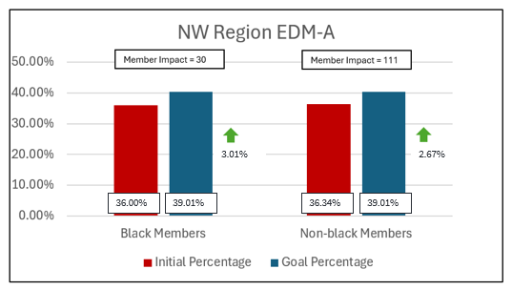
Project Populations – NW Region
Measure | Population | Total Population Count | Initial Percentage | Goal Percentage | Initial Denominator | Goal Denominator | Member Impact*
FUA | Black Members | 341 | 19.71% | 39.04% | 67 | 133 | 66 Members
FUA | Non-black Members | 1394 | 31.24% | 39.04% | 436 | 544 | 108 Members
EDM-A | Black Members | 688 | 36.00% | 39.01% | 248 | 278 | 30 Members
EDM-A | Non-black Members | 2757 | 36.34% | 39.01% | 1002 | 1113 | 111 Members
*Member Impact = # of members needed to improve to the defined target

Slide 7
Population Specific Needs
Identification of population specific needs is essential to quality improvement, especially when addressing health care disparities. Our projects are designed to improve outcomes across the entire population while prioritizing equitable impact to achieve meaningful change.
Key Guiding Principles:
Focus on Disparities
Equity as a Core Value
Intervention Impact Assessment
Strategy Examples:
Community Engagement
Addressing Barriers
Commitment to Accountability
Some Considerations:
Race & Ethnicity
Geographic Location
Age & Gender
In addition to addressing member equity, our projects prioritize equity among providers by recognizing the diverse needs and challenges that you may face. Providers play a critical role in delivering equitable care and ensuring that you have resources, support, and needed accommodations is essential to achieving true equity.
Provider considerations include:
Provider Type
Access to Resources
Community
Needed Support & Bandwidth

Slide 8

Voice of the Customer – Overall Learnings
Learnings
Hospitals are more likely to be able to offer direct follow-up care for members with mental health diagnosis vs those who have substance use disorder
Two-thirds of members are told of the importance of a follow-up visit
Members sometimes struggle to schedule their own follow-up appointments
Transportation and other Social Determinants of Health play a role in a member’s ability to complete a follow-up visit
CBOs rarely have a coordination process between themselves, providers, and members
Providers (BH & PCP) often express a need for improved data sharing methods and systems between hospital systems, the Provider, and MCOs
Reimbursement issues may prevent PCP Providers from providing aftercare (PH & BH Care on same DOS)
Common Failure Modes
Our Customers
Member SDoH Needs
Data Accuracy/Exchange
Care Coordination Practices
Provider CBO Reimbursement
Provider Access, Availability, and Bandwidth
Lack of Understanding Member MCO Benefits
Timely ADT Notifications
Accurate Member Contact Information
Members
Hospitals & Hospital Systems
Primary Care Providers
BH Providers
Community Based Organizations
Managed Care Organizations
FQHCs
Addiction Services Providers
CBHCs

Slide 9
Partnership & Benefits
Partnering gives you an opportunity to help us better understand the member and provider experience for those who visit the ED for SUD/MH:
  Interventions will be customized to your capabilities and workflows. Co-design is critical to the process!
  Testing starts very small – One Patient/One ED/One Provider
  The MCOs do the heavy lifting – Documentation, Coordination, Training
Partnering can bring several benefits to your system or practice:
  Collaboration with the MCOs to develop evidence-based practices for system-level improvements across Ohio
  Access to best practices and sharing of successful strategies
  Streamline care transitions and care coordination for your patients
  Improved patient outcomes and engagement – Directly impact patient outcomes by addressing barriers to care and services

Slide 10
Provider Intervention Planning
Intervention | Description | Measure(s)
Embedded Peer Support Services (in ED) | Integrates peer support specialists (individuals with lived experience of substance use recovery) into the Emergency Department to provide support to patients presenting with SUD. Peer Supports engage with patients/members to offer emotional support, share recovery resources, and facilitate connections to treatment and community services. | FUA EDM-A
BH Member Cell Phone Program | Ensures that members have reliable means of communication to access follow-up care, support services, and direct MCO assistance. | FUA EDM-A
Connection or Creation of Bridge Clinics | Establishes or connects patients/members to bridge clinics, designed to provide short-term care to those with SUD focusing on low-barrier access, MAT induction, and harm reduction while serving as a critical link between EDs and long-term OP care. | FUA
Same Day Billable BH and PH Care | Delivery and documentation of both physical health and behavioral health services to a patient by qualified providers during a single day, with each service meeting criteria for medical necessity and compliant billing, to improve access and care integration | FUA EDM-A
Strategic Engagement Incentive | Establishes financial and performance-based incentives for providers to proactively use available data to engage patients and ensure timely coordination of follow-up care. | FUA EDM-A
Transportation Assistance | Offering targeted transportation support to members and Providers including resource navigation, increased access, and direct connections to MCOs, with the goal of addressing barriers to timely follow-up care after ED visits. | FUA EDM-A

Slide 11
Partnership Discussion
Can you tell us a little about your organization and services provided?
Do you currently have any strategies to support individuals in the first week following an ED visit for substance use disorder or mental health concerns?
  If yes, what challenges have you encountered in ensuring timely follow-up care and how have you addressed them?
  Can you share any success stories or outcomes from your existing follow-up initiatives?
How can our organizations work together to address barriers to follow-up care for adults?
  Is there potential to test the MCO interventions with your organization?
  Are there any innovative approaches or best practices you have seen in other partnerships that we could consider?

Slide 12
Next Steps?
Ideas for partnership
Next steps for engagement and responsible parties
Scheduling follow-up meeting

Slide 13
Thank You!

