Slide 2
Central Intervention Team Members:
Erin Davis, LISW-S - Central Intervention Team Lead edavis3@amerihealthcaritasoh.com
Megan Vallandingham, PMP – Central Team Provider Engagement Lead megan.vallandingham@caresource.com
Nora Trimboli – Central Team Quality Intervention Lead Nora.Trimboli@anthem.com
Northwest Intervention Team Members:
Pam Sanborn, LISW-S – Northwest Intervention Team Lead pam.sanborn@caresource.com
Mary Anne Mayle – Northwest Team Provider Engagement Lead mmayle@amerihealthcaritasoh.com
Erin Tilbert, M.Ed, LPCC-S – Northwest Team Quality Intervention Lead erin_tilbert@uhc.com
Collaborative Core Leads:
Shelly Milvet, DNP, MHA, RN – Core MCO Lead shelly.milvet@uhc.com
Misty Nahay – Core QI Lead – mnahay@humana.com
Mary Kickel – Project Manager mkickel@humana.com

Slide 3
All MCO Quality Improvement Collaborative
The All MCO Quality Improvement Collaborative represents a dynamic partnership between the Ohio Department of Medicaid (ODM) and the state’s Medicaid Managed Care Organizations (MCOs). The goal of the collaborative is to address statewide health priorities and disparities. By leveraging collective experiences and using proven quality improvement science methodologies, the collaborative aims to achieve measurable and sustainable improvements in Medicaid health outcomes.
Adult Focused Project: 7-Day Follow-Up after ED Visit for Substance Use Disorder & 7-Day Follow-Up after ED Visit for Mental Health
The adult focused projects focus on providing Medicaid members with timely and coordinated care after emergency room visits for substance use and mental health diagnosis, connecting them to the right treatment and resources to improve health outcomes and promote effective engagement with the systems of care.

Slide 4
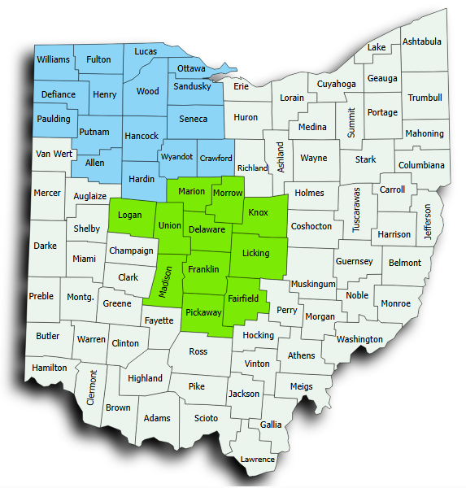
SMART AIMs*
Intervention/testing efforts are focused in the Central & Northwest Region​s:
FUA Overall Smart Aim:​
Increase the rate of follow-Up visits within 7 days of an ED visit for substance use for all adults on Medicaid aged 18 and older up to 39.04% by December 31, 2025. ​
  Black Adults
  Non-Black Adults
EDM-A Overall Smart AIM: ​
Increase the rate of follow-up visits within 7 days of an ED visit for mental health for all adults on Medicaid aged 18 and older to 39.01% by December 31, 2025. ​
  Black Adults
  Non-Black Adults
*Note: SMART Aims may be adjusted through the project lifecycle based on new information.

Slide 5
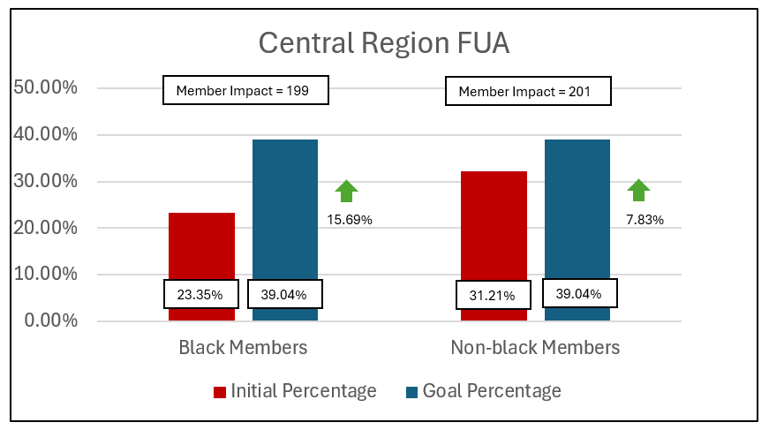
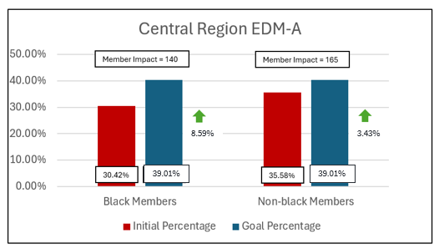
Project Populations – Central Region
Measure | Population | Total Population Count | Initial Percentage | Goal Percentage | Initial Denominator | Goal Denominator | Member Impact*
FUA | Black Members | 1270 | 23.35% | 39.04% | 297 | 496 | 199 Members
FUA | Non-black Members | 2937 | 32.21% | 39.04% | 946 | 1147 | 201 Members
EDM-A | Black Members | 1412 | 30.42% | 39.01% | 430 | 570 | 140 Members
EDM-A | Non-black Members | 3454 | 35.58% | 39.01% | 1229 | 1394 | 165 Members
*Member Impact = # of members needed to improve to the defined goal

Slide 6
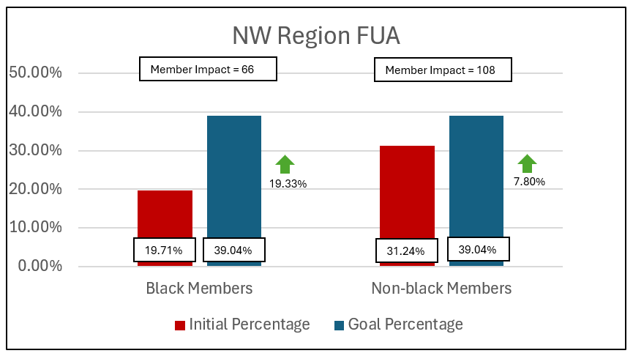
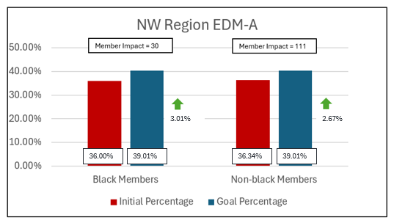
Project Populations – NW Region
Measure | Population | Total Population Count | Initial Percentage | Goal Percentage | Initial Denominator | Goal Denominator | Member Impact*
FUA | Black Members | 341 | 19.71% | 39.04% | 67 | 133 | 66 Members
FUA | Non-black Members | 1394 | 31.24% | 39.04% | 436 | 544 | 108 Members
EDM-A | Black Members | 688 | 36.00% | 39.01% | 248 | 278 | 30 Members
EDM-A | Non-black Members | 2757 | 36.34% | 39.01% | 1002 | 1113 | 111 Members
*Member Impact = # of members needed to improve to the defined target

Slide 7
Population Specific Needs
Identification of population specific needs is essential to quality improvement, especially when addressing health care disparities. Our projects are designed to improve outcomes across the entire population while prioritizing equitable impact to achieve meaningful change.
Key Guiding Principles:
Focus on Disparities
Equity as a Core Value
Intervention Impact Assessment
Strategy Examples:
Community Engagement
Addressing Barriers
Commitment to Accountability
Some Considerations:
Race & Ethnicity
Geographic Location
Age & Gender
In addition to addressing member equity, our projects prioritize equity among providers by recognizing the diverse needs and challenges that you may face. Providers play a critical role in delivering equitable care and ensuring that you have resources, support, and needed accommodations is essential to achieving true equity.
Provider considerations include:
Provider Type
Access to Resources
Community
Needed Support & Bandwidth

Slide 8

Voice of the Customer – Overall Learnings
Learnings
Hospitals are more likely to be able to offer direct follow-up care for members with mental health diagnosis vs those who have substance use disorder
Two-thirds of members are told of the importance of a follow-up visit
Members sometimes struggle to schedule their own follow-up appointments
Transportation and other Social Determinants of Health play a role in a member’s ability to complete a follow-up visit
CBOs rarely have a coordination process between themselves, providers, and members
Providers (BH & PCP) often express a need for improved data sharing methods and systems between hospital systems, the Provider, and MCOs
Reimbursement issues may prevent PCP Providers from providing aftercare (PH & BH Care on same DOS)
Common Failure Modes
Our Customers
Member SDoH Needs
Data Accuracy/Exchange
Care Coordination Practices
Provider CBO Reimbursement
Provider Access, Availability, and Bandwidth
Lack of Understanding Member MCO Benefits
Timely ADT Notifications
Accurate Member Contact Information
Members
Hospitals & Hospital Systems
Primary Care Providers
BH Providers
Community Based Organizations
Managed Care Organizations
FQHCs
Addiction Services Providers
CBHCs

Slide 9
Provider Partnership & Benefits
Partnering gives you an opportunity to help us better understand the member and provider experience for those who visit the ED for SUD/MH:
  Interventions will be customized to your capabilities and workflows. Co-design is critical to the process!
  Testing starts very small – One Patient/One ED/One Provider
  The MCOs do the heavy lifting – Documentation, Coordination, Training
Partnering can bring several benefits to your system or practice:
  Collaboration with the MCOs to develop evidence-based practices for system-level improvements across Ohio
  Access to best practices and sharing of successful strategies
  Streamline care transitions and care coordination for your patients
  Improved patient outcomes and engagement – Directly impact patient outcomes by addressing barriers to care and services

Slide 10
Provider Intervention Planning
Intervention | Description | Measure(s)
Embedded Peer Support Services (in ED) | Integrates peer support specialists (individuals with lived experience of substance use recovery) into the Emergency Department to provide support to patients presenting with SUD. Peer Supports engage with patients/members to offer emotional support, share recovery resources, and facilitate connections to treatment and community services. | FUA EDM-A
BH Member Cell Phone Program | Ensures that members have reliable means of communication to access follow-up care, support services, and direct MCO assistance. | FUA EDM-A
Connection or Creation of Bridge Clinics | Establishes or connects patients/members to bridge clinics, designed to provide short-term care to those with SUD focusing on low-barrier access, MAT induction, and harm reduction while serving as a critical link between EDs and long-term OP care. | FUA
Same Day Billable BH and PH Care | Delivery and documentation of both physical health and behavioral health services to a patient by qualified providers during a single day, with each service meeting criteria for medical necessity and compliant billing, to improve access and care integration | FUA EDM-A
Strategic Engagement Incentive | Establishes financial and performance-based incentives for providers to proactively use available data to engage patients and ensure timely coordination of follow-up care. | FUA EDM-A
Transportation Assistance | Offering targeted transportation support to members and Providers including resource navigation, increased access, and direct connections to MCOs, with the goal of addressing barriers to timely follow-up care after ED visits. | FUA EDM-A

Slide 11
Intervention Discussion
Embedded Peer Support Services (in ED:
Integrates peer support specialists (individuals with lived experience of substance use recovery) into the Emergency Department to provide support to patients presenting with SUD or Mental Health Conditions.
Do you currently work with a partner in this space?
  What is current day process?
  How effective is process and ideas for how we can codesign to improve?
BH Cell Phone Program:
Ensures that members have reliable means of communication to access follow-up care, support services, and direct MCO assistance.
Have you experienced issues with reaching patients due to lack of phone access?
  Would providing phones with unlimited talk, text, and data help your patients better engage in treatment, follow-up visits, or case management?
What barriers do your patients report in staying connected to the healthcare system (health information, transportation, or virtual care)?
Bridge Clinics:
Establishes or connects patients/members to bridge clinics, designed to provide short-term care to those with SUD focusing on low-barrier access, MAT induction, and harm reduction while serving as a critical link between EDs and long-term OP care.
Does your organization work with a Bridge Clinic?
  If not, are you interested in developing one with support?

Slide 12
Intervention Discussion
Same Day Billable BH and PH Care:
Enabling Primary Care Providers to deliver same-day, billable BH and PH services during a single office visit.
Do you currently provide BH and PH services together on the same day of service?
  Do you currently bill for BH and PH care together on the same day of service?
  Are there any challenges to your organization completing these visits together?
Strategic Engagement Incentive:
Establishes financial and performance-based incentives for providers to proactively use available data to engage patients and ensure timely coordination of follow-up care.
How do you currently identify patients in need of follow-up care
What systems or tools do you have in place to reach out to patients and coordinate follow-up appointments?
How do you monitor and report performance metrics related to patient engagement and follow-up care?
Transportation Assistance:
Offering targeted transportation support to members and Providers including resource navigation, increased access, and direct connections to MCOs, with the goal of addressing barriers to timely follow-up care after ED visits.
How do you currently identify patients who may face transportation barriers to accessing care?
How do you coordinate or facilitate transportation services for patients with identified needs?

Slide 13
Next Steps
Ideas for partnership
Next steps for engagement and responsible parties
Scheduling follow-up meeting

Slide 14
Thank You!

Slide 15
Appendix

Slide 16
Substance Use Response and Engagement (SURE) Provider Advisory Council
We are actively inviting healthcare organizations, providers, care givers, community-based organizations, and family members with SUD and/or Mental Health treatment experience to voluntarily participate in the Ohio Medicaid MCO Substance Use Response and Engagement (SURE) Advisory Council. Being a member of the SURE Advisory Council provides you with a unique opportunity to:
Contribute to the success of the Ohio Medicaid Managed Care SUD and Mental Health related Quality Improvement work
Make a positive impact on Ohio Medicaid members and families
Serve your community by helping to evolve and improve our system of care
Expand your network and meet people with similar experience
Working together with ODM, the Ohio MCOs need the support and input of people with your experience and insight. The main purpose of the SURE Advisory Council is to be “SURE” that our members who have visited an emergency room due to an overdose, substance use event, or mental health related illness are given every opportunity to access and engage ongoing help and resources for their condition.
Advisory board meetings are held monthly, running through December 2025 and are an hour in duration.
If interesting in joining, please let us know!

Slide 17
FUA Creditable Visits
Include visits and pharmacotherapy events that occur on the date of the ED visit.
Outpatient Visit
With any diagnosis of SUD, substance use or drug overdose
Intensive OP/Partial Hosp
POS 52 - With any diagnosis of SUD, substance use or drug overdose
Non-Res Treatment
With any diagnosis of SUD, substance use or drug overdose
Community Mental Health
Peer Support
POS 53 - With any diagnosis of SUD, substance use or drug overdose
With any diagnosis of SUD, substance use or drug overdose
With a mental health provider
With a mental health provider
POS 52 - With a mental health provider
With any diagnosis of SUD, substance use or drug overdose
POS 53 - With a mental health provider
or
or
or
or
or
Telehealth/ Telephone
With any diagnosis of SUD, substance use or drug overdose
E-visit / Virtual Check-in
With any diagnosis of SUD, substance use or drug overdose
BH Screening / Assessment
A behavioral health screening or assessment for SUD or mental health disorders
Pharma
Opioid Treatment
A pharmacotherapy dispensing event or medication treatment event
Opioid treatment service that bills monthly or weekly with any diagnosis of SUD, substance use or drug overdose
With a mental health provider
With a mental health provider
or
or

Slide 18
FUA Creditable Visits (continued)
Include visits and pharmacotherapy events that occur on the date of the ED visit.
Place of Service
School
Type of Service
Visit with a Social worker
Prison/Correctional Facility
Office
Home
Assisted Living Facility
Group Home
Mobile Unit
Temporary Lodging
Walk-in Retail Health Clinic
Place of Employment-Worksite
Off or On Campus-Outpatient Hospital
Urgent Care Facility
Custodial Care Facility
Independent Clinic
Federally Qualified Health Center
Public Health Clinic
Rural Health Clinic
Activity therapy
Hospital outpatient clinic visit
Rural health clinic or federally qualified health center (rhc/fqhc) visit
Behavioral health counseling and therapy
Mental health assessment, by non-physician
Medication training and support
Community psychiatric supportive treatment
Assertive community treatment
Crisis intervention service
Psychiatric health facility service
Comprehensive community support services
Therapeutic behavioral services, per 15 minutes (H2019)
Mental health support groups staff facilitated
Mental health support groups staff facilitated
Mental health functional therapies
Postoperative follow-up visit
Office visit for pediatric care and assessment
Annual wellness visit

Slide 19
EDM-A Creditable Visits
Does not include visits on the same day as the ED visit.
A follow-up visit with any practitioner, with a principal diagnosis of a mental health disorder or Substance Use Disorder within 7 days after the ED visit
Primary MH or SUD diagnosis on outpatient/professional medical claim with one of providers or services listed below:
Has one of the following service codes (no restrictions on place of service or provider type):
Billing or rendering provider type* of 42 (psychologist), 84 (CMHC), 95 (SUD Tx Center), 37 (Social Worker), 47 (Clinical Counselor), 52 (Marriage and Family Therapist), 96 (Behavioral Health Paraprofessional)
POS code 55 (SUD residential treatment center) or 56 (psychiatric residential treatment center) *
Mental health or SUD revenue code
BH Procedure code
E&M Procedure code
*If only service on claim with PT or POS is a drug screen, drop

