Slide 1
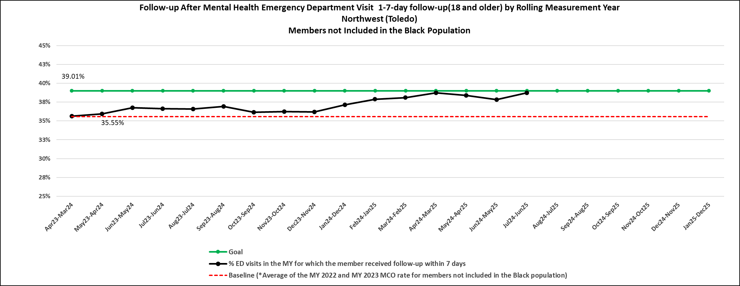
EDM-A SMART Aim Run Chart
Mental Health 7-day follow-up (18 and older) - NW Region - Members not Included in the Black Population
Rolling Measurement Year
Data source : ODM Published SMART Aim Performance

Slide 2
EDM-A SMART Aim Run Chart
Mental Health 7-day follow-up (18 and older) - NW Region - Members Included in the Black Population
Rolling Measurement Year
Data source : ODM Published SMART Aim Performance

Slide 3
EDM-A SMART Aim Run Chart
Mental Health 7-day follow-up (18 and older) - Central Region – Members not Included in the Black Population
Rolling Measurement Year
Data source : ODM Published SMART Aim Performance

Slide 4
EDM-A SMART Aim Run Chart
Mental Health 7-day follow-up (18 and older) - Central Region – Members Included in the Black Population
Rolling Measurement Year
Data source : ODM Published SMART Aim Performance

